Slide 1
ÉCLAIRE gender questionnaire
37 responses:
Males: 23
Females: 14

Slide 2
ÉCLAIRE gender questionnaire
Average age for male: 44.4years old
Average age for female: 43.5 years old
Average number for children for male:1.3
Average number for children for female:1.2
Most respondents are on permanent positions (17 out of 23 males, 13 out of 14 females)

Slide 3
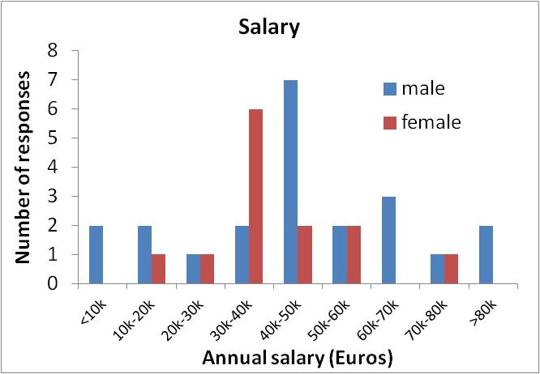
ÉCLAIRE gender questionnaire
Despite equal distribution of age, seniority and numbers of children, there is a disparity in salary

Slide 4
ÉCLAIRE gender questionnaire
What was the perception of discrimination?
36% females and 4% of males thought that gender had or would have a negative impact on their career
Reasons were often family related – to do with childcare, long gaps due to maternity leave, domestic responsibilities and commitments
Some men commented on possible problems from positive discrimination for female research leaders in the future
Other comments included that many women drop out of science after completing their PhD
On a positive side - nobody thought that their contributions to ECLAIRE activities were/would be compromised due to gender

Slide 5
ÉCLAIRE gender questionnaire
57% of men and 79% of women thought that gender was an issue in science
Some mentioned that this was an issue in general, not specifically in science
Often family responsibilities coincide with the critical time in a career when producing peer-reviewed literature is necessary, and full dedication to science is needed to progress
The child-care/family issues also relate to men (some of whom commented that there is less acceptance of men taking ‘career breaks’ to bring up a family than for women)
Long maternity breaks within a PhD or post-doctoral position are tricky for both the woman concerned and for the fulfilment of the project (which is often only for 3 years)

Slide 6
ÉCLAIRE gender questionnaire
What can be done at a project level:
- Flexible working arrangements
- Some funding for childcare support, particularly during meetings
- Possibility of ‘online’ participation at meetings
- Ensuring that equal access is given to ‘leadership’ roles and chairmanships
25% of men and only 8% of women thought that there should be gender sessions within ECLAIRE meetings
90% of respondents thought that ad-hoc activities, like questionnaires, managing the gender forum on the website, or organising a career development session with a trainer would be sufficient

